Slide 1
scRNA-Seq-H3 ToolKits

Slide 2
Simple 1 step nextflow
nextflow: single step
nextflow: 1 step pipeline
Dnmt3a Dataset
Put the GSE number for the dataset

Slide 3
Goal: nextflow run h3biomed/cellranger –input dataset
Current Issues: (Solved)
Docker: Working with IT to get access
AWS: h3-computationalbiology role unable to use AWS credentials
Can’t test AWS batch or aws genomics (can be used to sit on top of nextflow to manage aws usage)
Single Step NextFlow Pipelines
SRA Processing
Cell Ranger
QC Filtering
CellType Calling
Each Single Step Pipeline Requires Environment Setup Correctly

Slide 4
SRA Processing

Slide 5
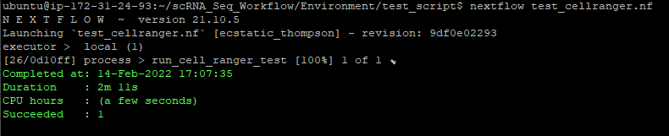
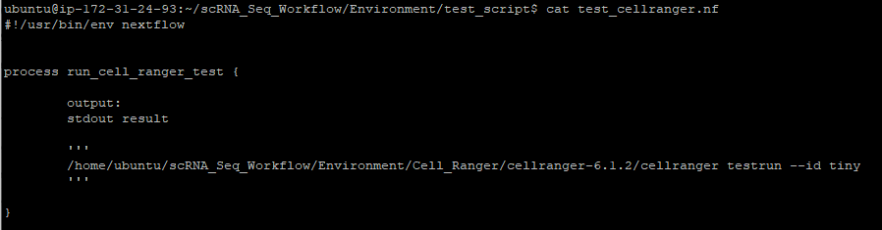
Nextflow-Cell Ranger Simple Concept
Steps:
Install Cell Ranger
Write simple one line bash script to run cell ranger
Write Nextflow Process to run Bash Script
Test by running bashscript & cellranger command

Slide 6
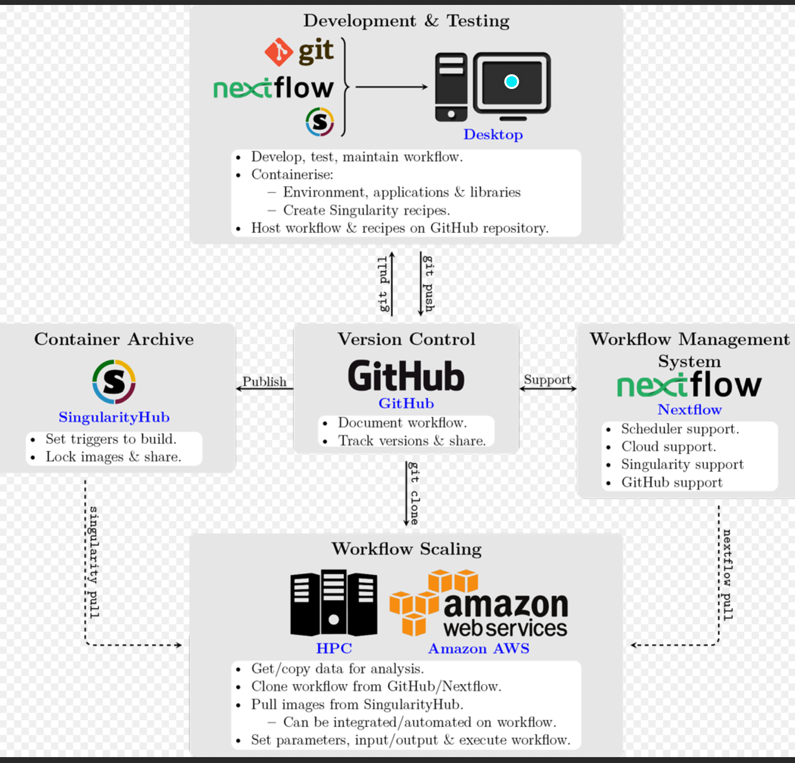

Slide 7
QC Filtering

Slide 8
CellType Calling

Slide 9
Next Proof Of Concept: AWS Batch

Slide 10
Full Nextflow Pipeline
SRA Download (pulls lifebit/kallisto-sra docker imager)
CellRanger (local install of CellRanger)
QC Filter (local renv install)
CellType Calling (local renv install)

Slide 11
scRNA-Seq Analysis Tools Overview
Phase 1:
Input: Cell Ranger Output
Output: Cell Type Calling & QC Cleanup
Phase 2:
Input: SRA Project ID (External Datasets)
Output: Cell Type Calling & QC Cleanup
Computing Infrastructure:
Single AWS Instance + AMI
Modular
Cell Type Calling (R)
QC Cleanup (R)
SRA Processing (Python)
Cell Ranger (Bash)

Slide 12
Instance Folder Structure
Data
Project ID
Setup_Instance.sh
Fastq
Cell Ranger Output
scRNA_Seq_Workflow
Environment
Full_Workflow.sh
SRA
scRNA-Seq_QC
Cell_Type_Calling
= Folders
Final_Output
= Bash Script
Project ID

Slide 13
Setup_Instance.sh = Setup Complete AWS Instance
Installation: Setup_Instance.sh (will become docker file)
Setup Ubuntu Environment
Setup R Environment File (R version: 4.0.3)
Install Global R Packages
Setup Each Module R Environment as Separate
scRNA-Seq QC Filtering (Using Modified Version of Yaoyu’s Tutorial (better then SBG format))
scRNA-Seq Cell Calling

Slide 14
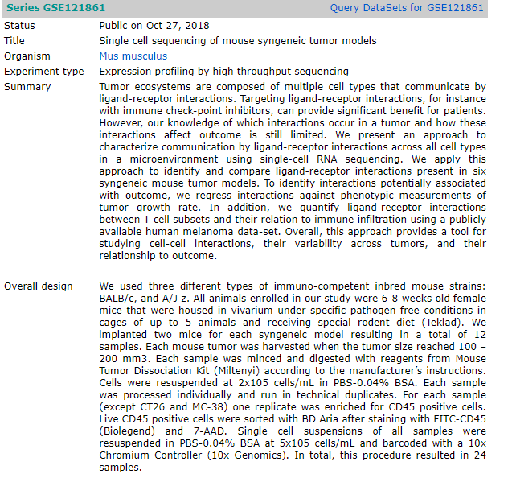
Datasets Used
PMBC (10x)
SRP166967 (GSE121861)
DNMT3a Dataset

Slide 15
FAQ
Cell Ranger

